Slide 1

Mobility platform in Aveiro Tech City Living Lab Infrastructure
Milestone 4
Diogo Mendes, 88801
Hugo Leal, 93059
Luísa Amaral, 93001
Maria Cunha, 93089
Pedro Loureiro, 92953
Supervisors:
Dr.ª Susana Sargento
Dr. Pedro Rito

Slide 2
Introduction

Slide 3
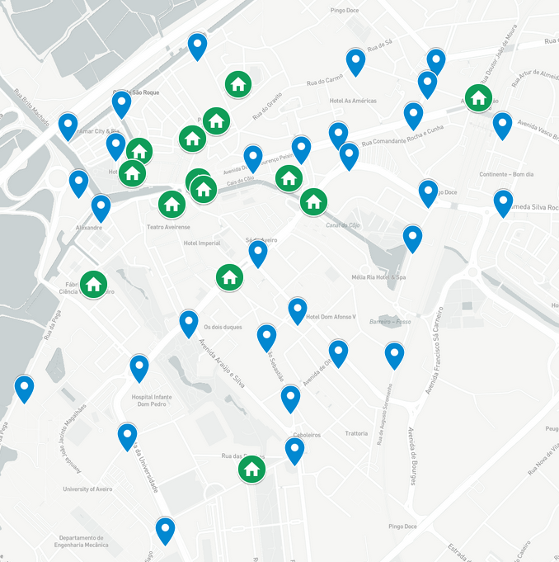
Context
In Aveiro there are 44 stations installed and interconnected with fibre
The stations contain environmental sensors, radars, LIDARs, video cameras and computer edge units
This infrastructure is connected to the data center in IT
Goal: build a tech city living lab as a complete connected city to experiment future services and applications in a real environment
green home → buildings
blue pins → smart lamp posts
Notes:
[Hugo]

Slide 4
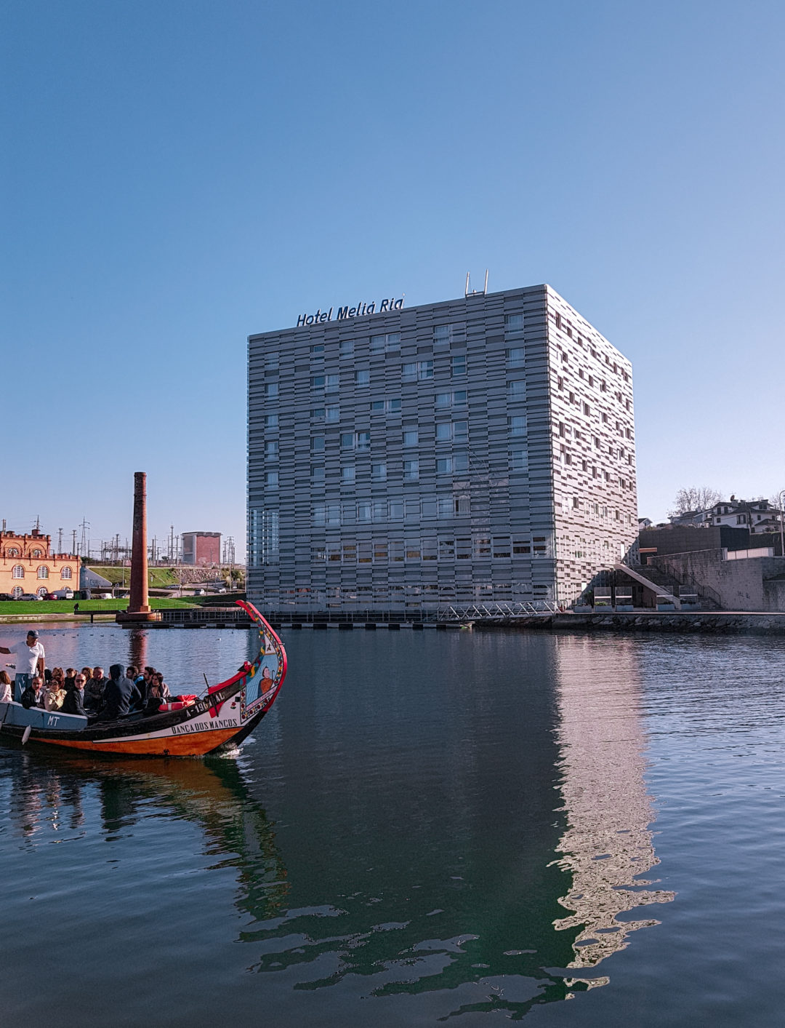
Problem
Enrich the Aveiro Tech City Living Lab (ATCLL) infrastructure in order to improve the lifestyle of citizens and for research purposes
The Aveiro’s Town Hall proposed a task:
To monitor people in public spaces
To monitor the quantity and frequency of moliceiros in the Ria de Aveiro
To monitor people in the moliceiros in the Ria de Aveiro
Notes:
[Hugo]

Slide 5
Initial goals (I)
Develop solutions to get values from the sensors and understand which type of sensors to use
Develop mechanisms to detect people, moliceiros, movement, etc.
Use of different sensors
WiFi devices detection
Video AI for object detection
Sensor fusion and processing
Notes:
[Hugo]
(considering video cameras also as sensors)

Slide 6
Initial goals (II)
Develop a subscription broker to accumulate past and real time data
Develop a web application to show the subscription broker’s data
Overall data processing, persistence, analytics and visualization in the web application
Improve team-working skills and learn how to work with new technologies and equipments
Documentation writing
Notes:
[Hugo]

Slide 7
How to?
Collect information regarding the number of people, cars, bicycles and moliceiros in certain areas of the city
Use of object detection models to count the objects from the live video of cameras
Use of Wi-Fi sniffing to count the number of devices near the smart lamp post
Display of the data in a dashboard so that it may be observed by the public
Notes:
[Maria]

Slide 8
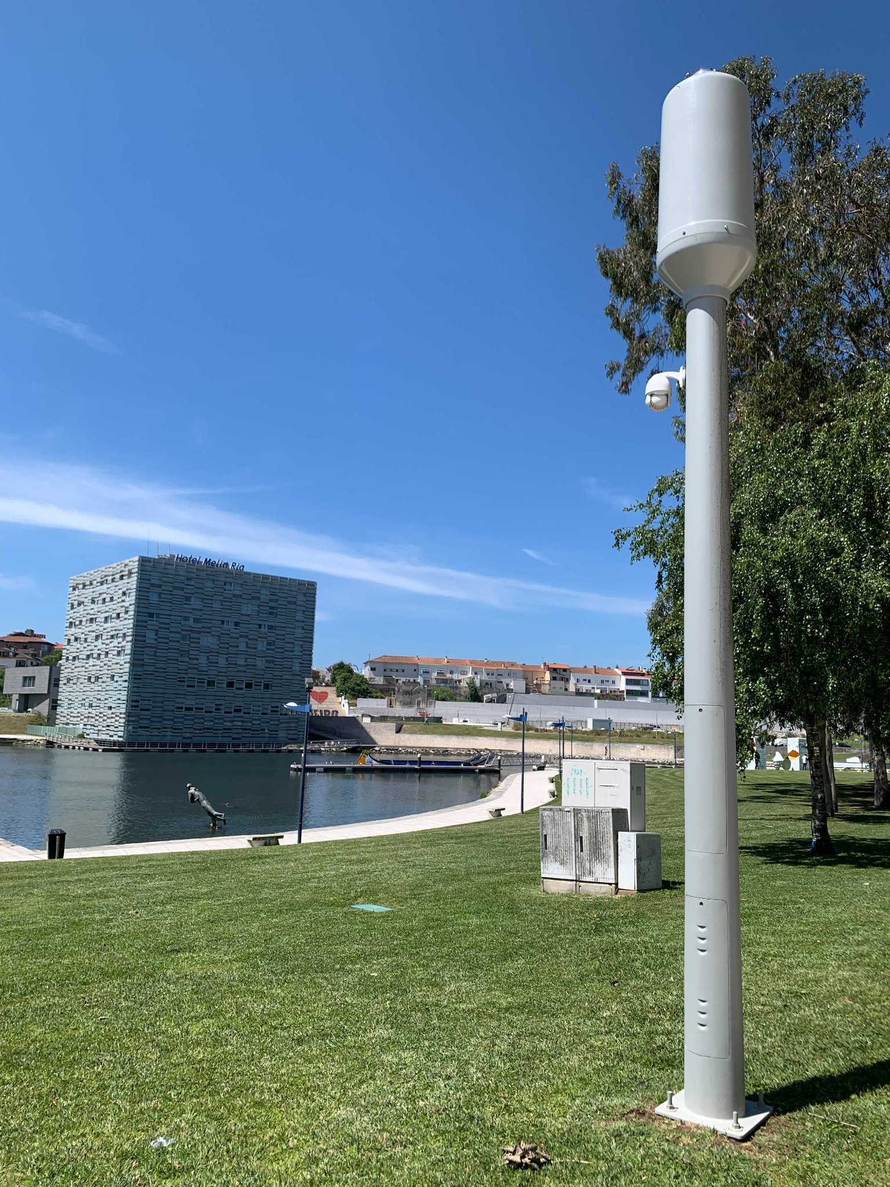
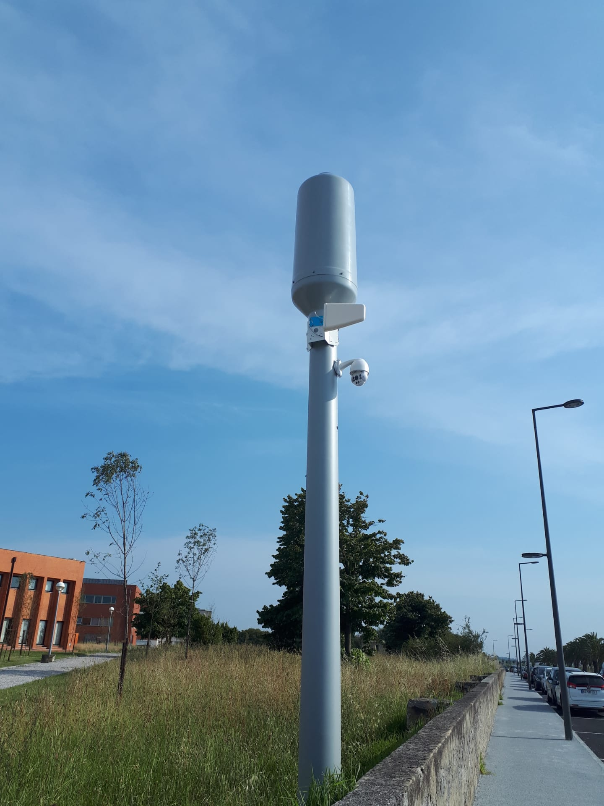
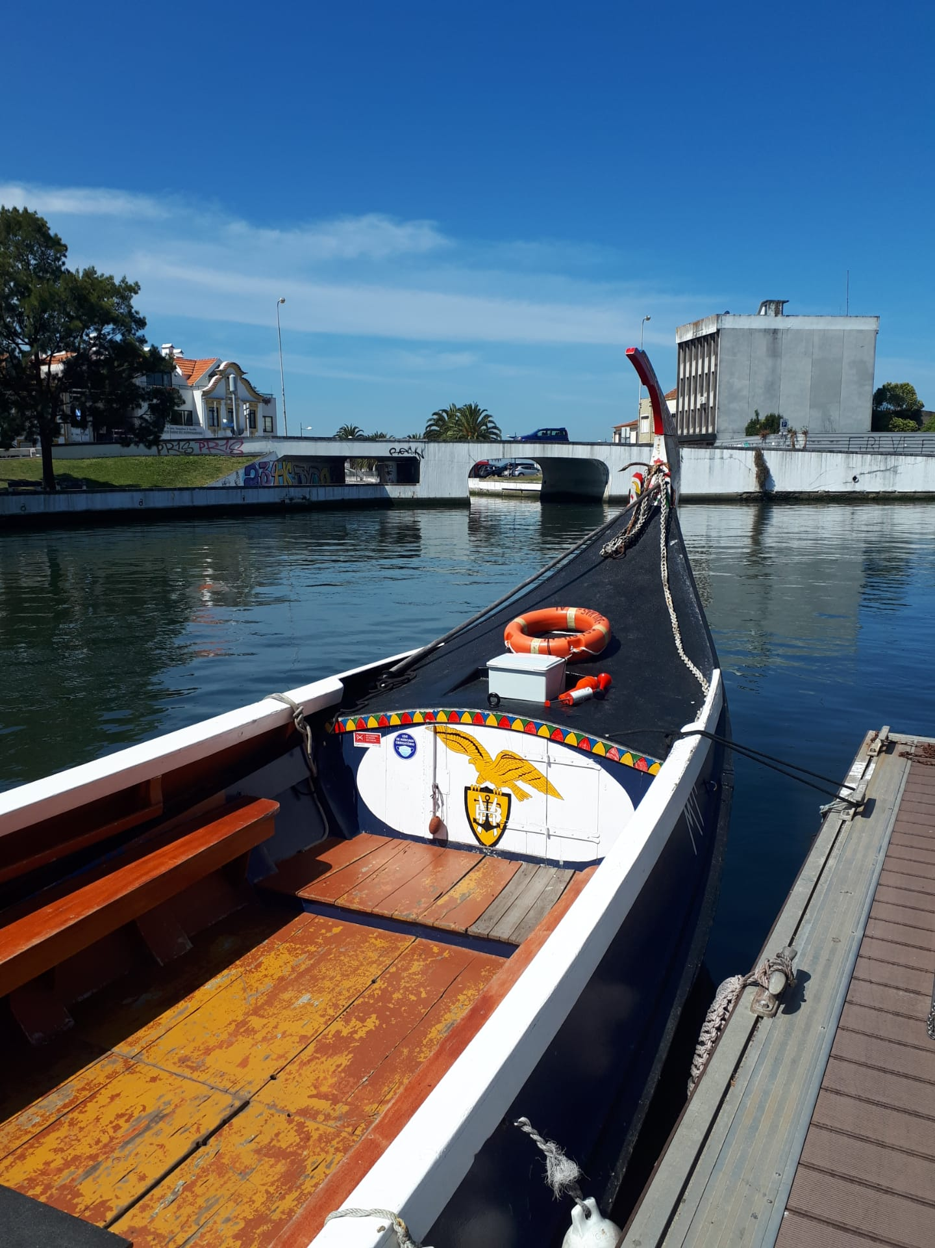
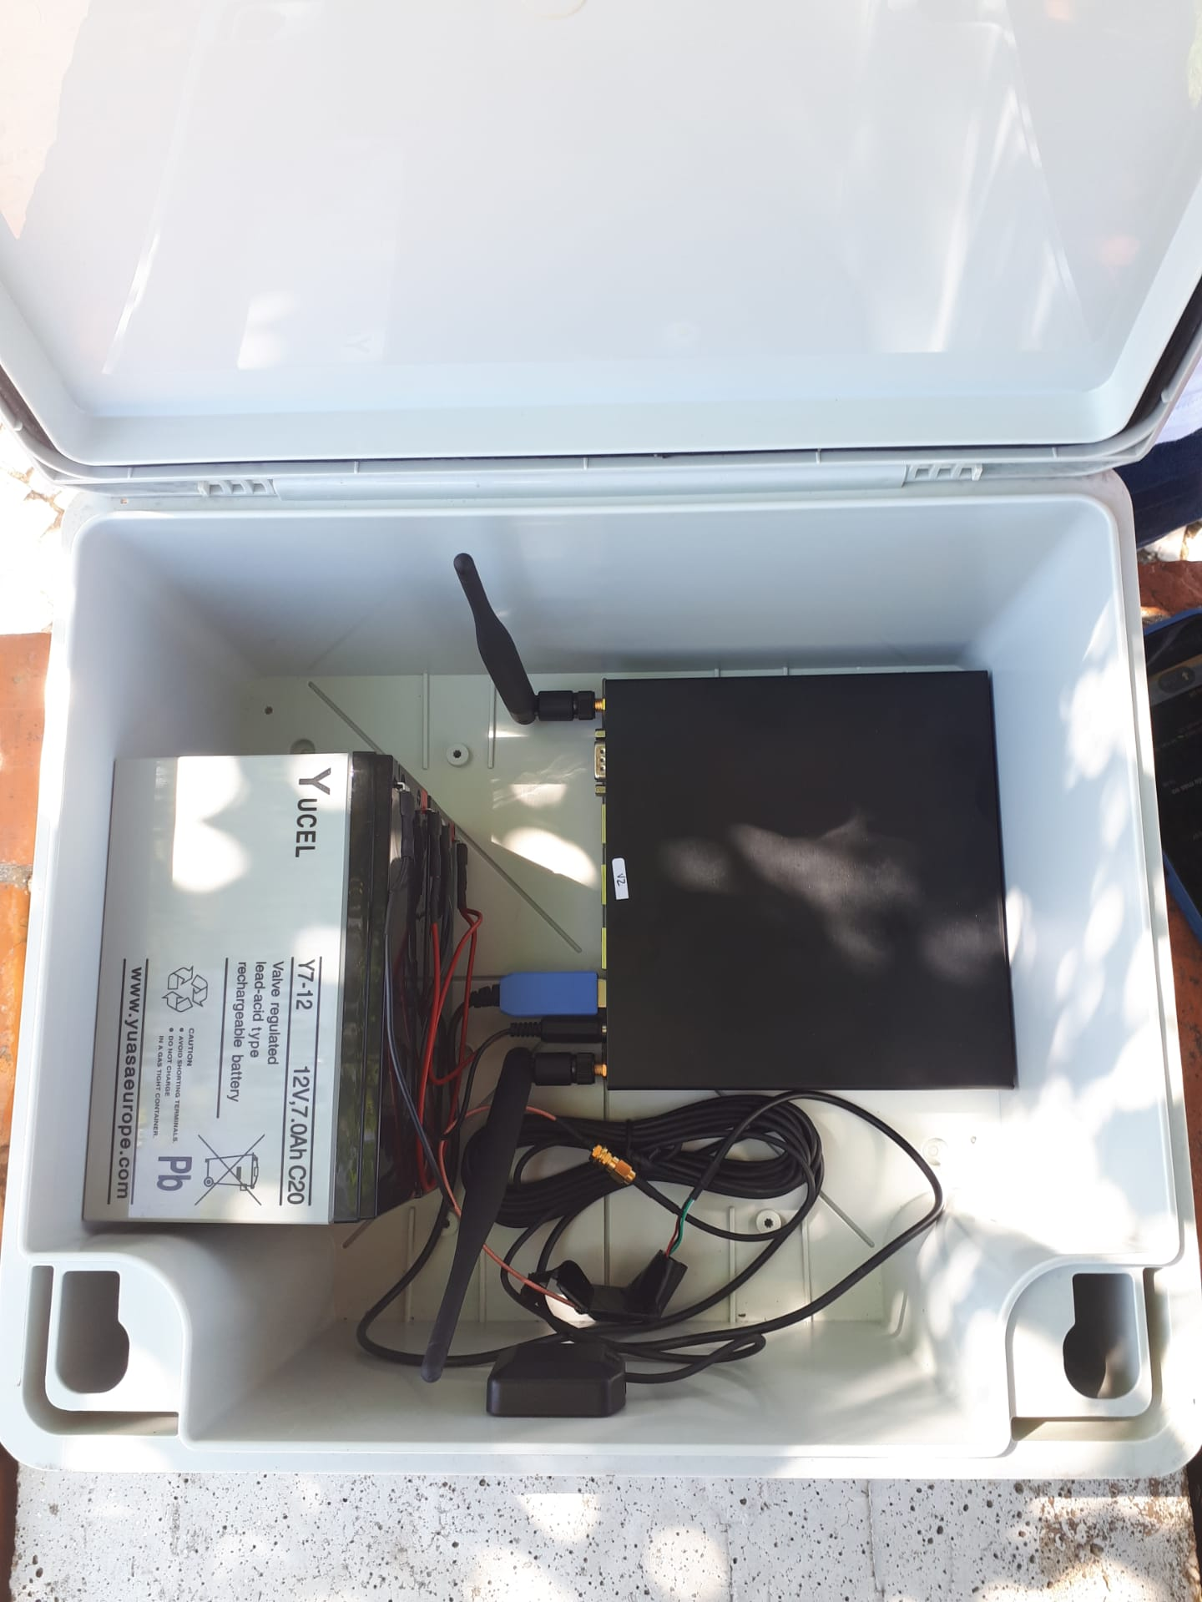
Our resources
Notes:
[Maria]

Slide 9
Expected Results
Detection mechanisms:
Vision and communication-based
Objects and movement
Aggregated detection
A web application to present the results obtained in real-time as well as past results
Detection of people, moliceiros and vehicle movements
Analysis of the collected data
Make use of the infrastructure to integrate people and moliceiros
Expand the Aveiro Tech City Living Lab project
Notes:
[Maria]

Slide 10
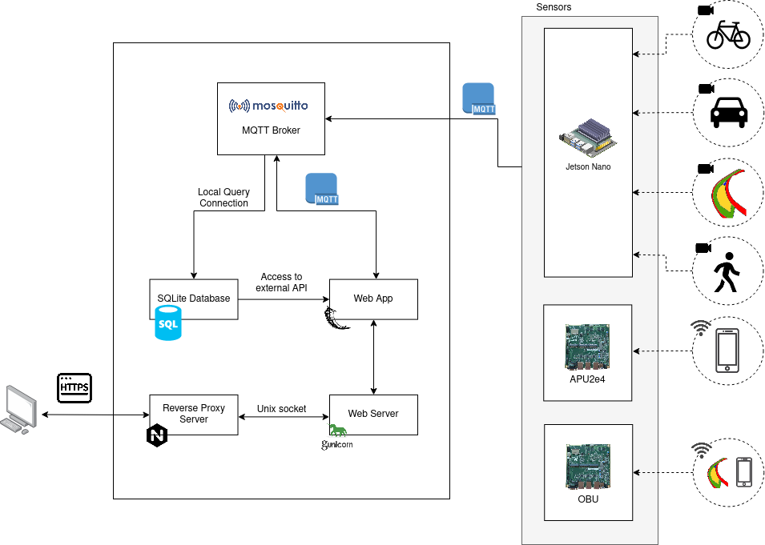
Architecture of the project
Notes:
[Maria]
estes aparelhos comunicam com os sensores
os dados vêm dos sensores para ao broker central através de MQTT
a nossa app, que é um serviço Flask, comunica com o broker para obtenção dos dados
os dados do broker são persistidos na base de dados (Sqlite)
a nossa app que acede a base de dados através de uma api externa para obtenção de valores persistidos
o gunicorn cria um servidor que hospeda a aplicação web
o nginx é um servidor de proxy reverso que encaminha os pedidos https para o web server Gunicorn através de um socket unix

Slide 11
Data Acquisition
Notes:
[Luisa]

Slide 12
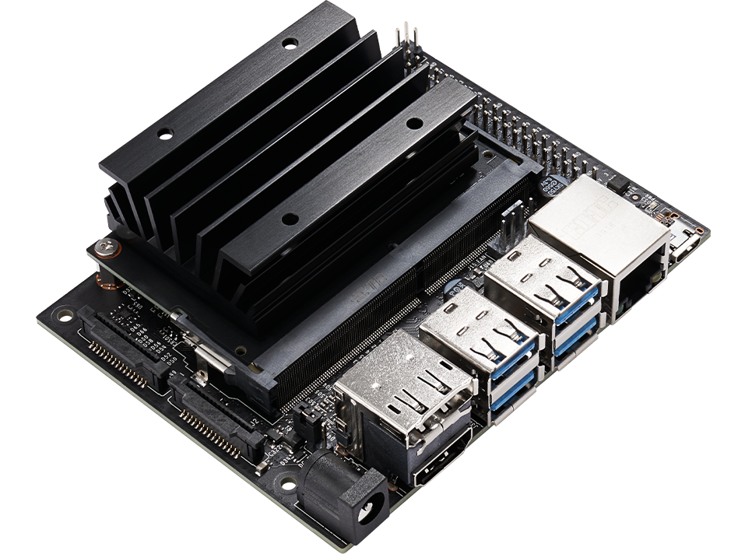
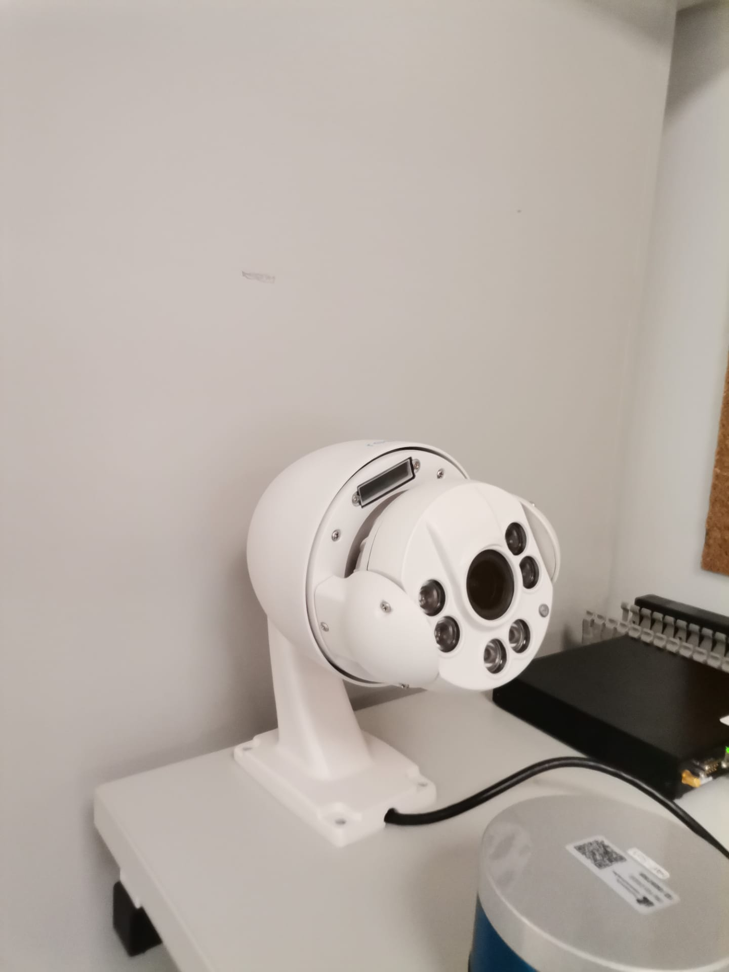
Detection Module (I)
Use of a Nvidia Software Development Kit, DeepStream, which was installed in two Jetson Nanos to allow video streaming analysis
Detection of people, vehicles, two wheeler vehicles and moliceiros using python scripts
Data sent to two topics of each local broker and then received by IT’s central MQTT broker to be persisted
The web application backend receives the data and displays it in the dashboard
Notes:
[Luisa]

Slide 13
Detection Module (II)
Problem | Solution
Loss of frames due to clock discrepancies | Script adjusted based on information found in Nvidia forums
Values very high due to noise in the image | Search of false detection patterns to filter of unwanted areas and adjustment of the threshold
No DeepStream model to perform moliceiros detection | Use of python library OpenCV
Impossibility of using OpenCV and DeepStream at the same time in the same Jetson Nano | To be solved in future work
Notes:
[Luisa]

Slide 14
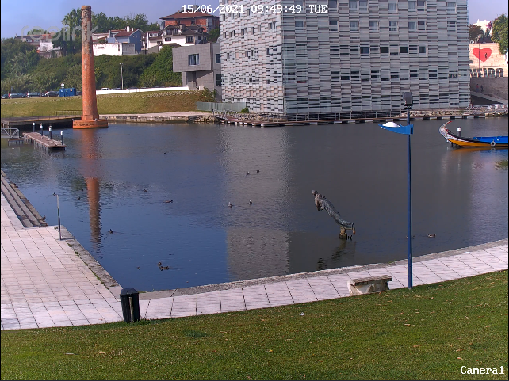
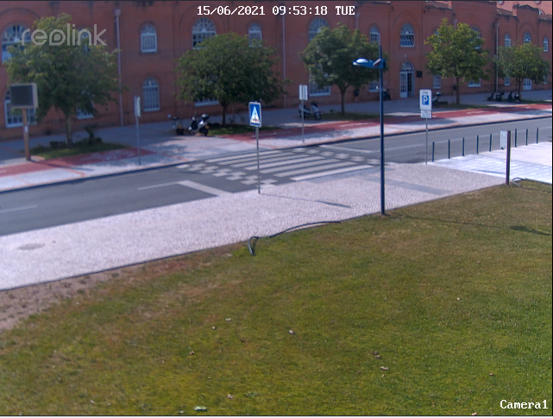
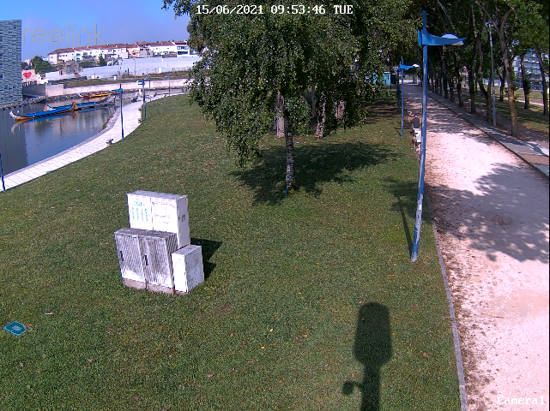
Detection Module (III)
Three different positions of the camera
Moliceiros + People position
Cars + People position
People position
Notes:
[Luisa]

Slide 15
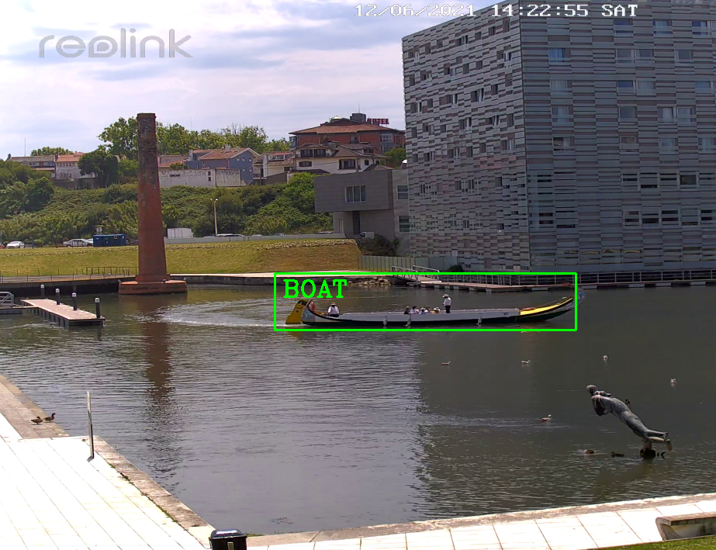
Detection Module (IV)
Detection of people, vehicles, two wheeler vehicles and moliceiros
Frame processing of 30 FPS
Notes:
[Luisa]

Slide 16
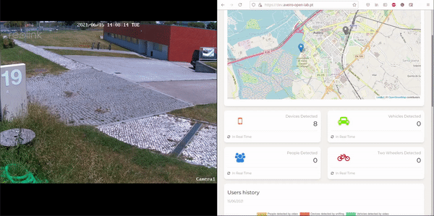
Detection Module (V)
Notes:
[Luisa]

Slide 17
WiFi Detection Module (I)
Detection of devices near the smart lamp posts through WiFi
Estimation of the current number of devices in real time as well as the number of different people that pass near the Smart Lamp Posts
Send data to the central broker in order to be persisted and shown in the web application
Notes:
[Pedro]

Slide 18
WiFi Detection Module (II)
The sniffing module captures WiFi probe request packets through the APU’s/OBU’s wireless network adapter set in monitor mode
Every time a new packet is captured, the handler extracts the sender’s mac address and stores it
The current nearby MAC addresses are stored in a list and deleted after 5 seconds of not emitting probe requests
The unique devices are stored in a set which is cleared in intervals of 10 minutes
This data is sent to the 2 topics of each local broker and then is received by the IT’s central MQTT Broker where data is persisted.
Notes:
[Pedro]

Slide 19
WiFi Detection Module (III)
Problem | Solution
The sniffing module used 100% of the APU’s CPU which led to a crash in the APU | Use of another program to capture and filter packets in order to diminish the CPU usage: pyshark
Routers probe requests were being counted as a device | Excluded packets that contained an SSID and that were not broadcasted
Very high number of devices detected | Adjusted the detected packages time to live to obtain more accurate results
Notes:
[Pedro]

Slide 20
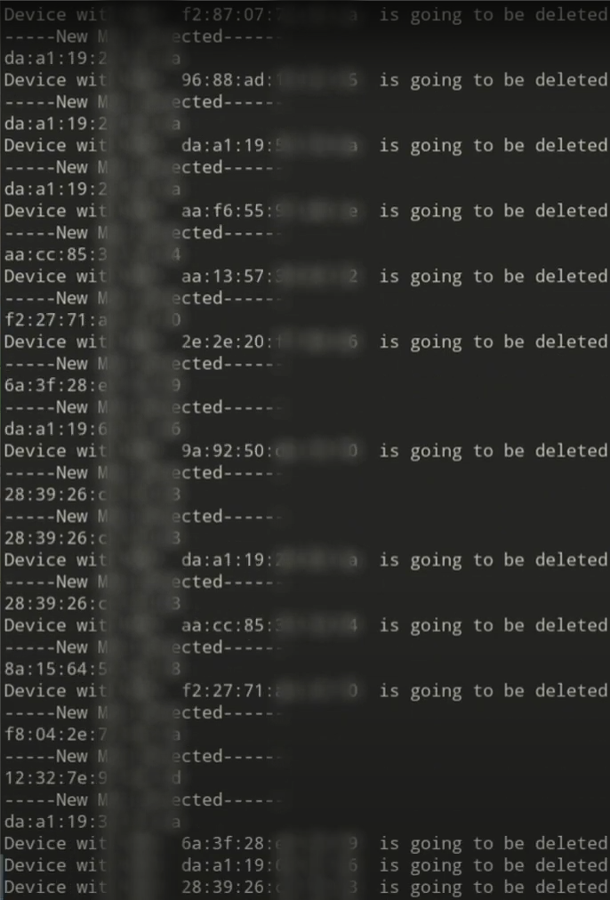
WiFi Detection Module (IV)
We are able to detect devices near the Smart Lamp Posts with a good level of confidence
Notes:
[Pedro]

Slide 21
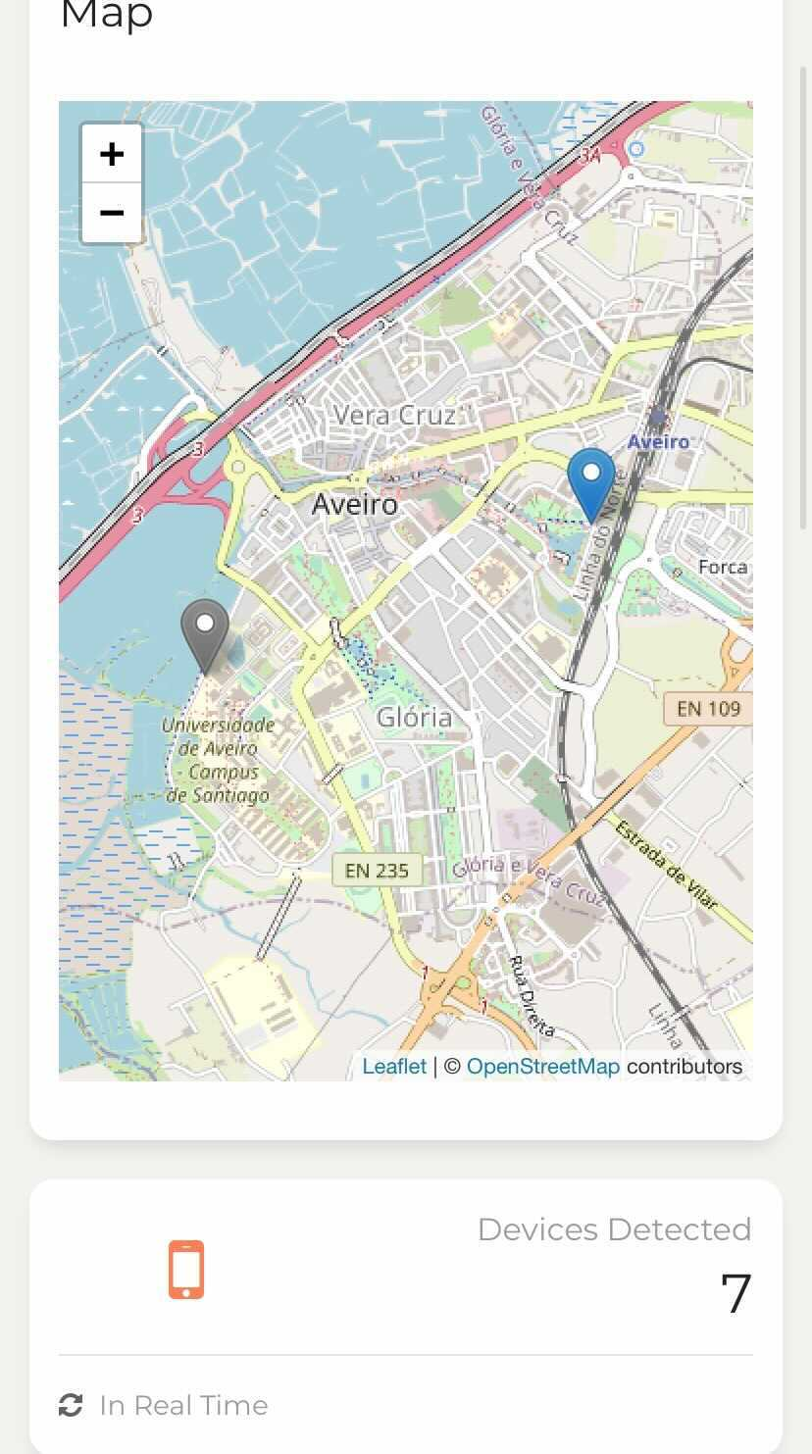
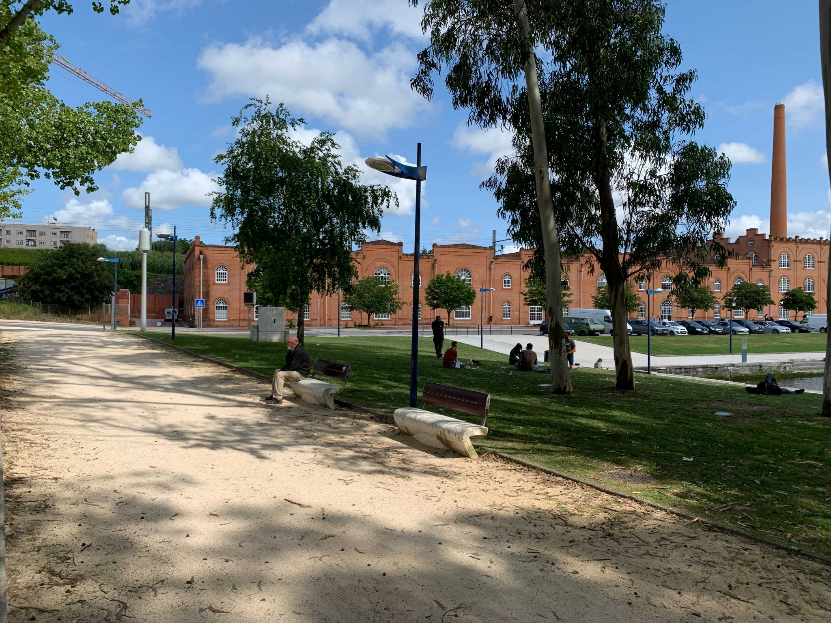
WiFi Detection Module (V)
Notes:
[Pedro]

Slide 22
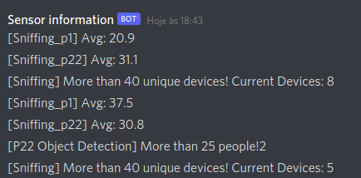
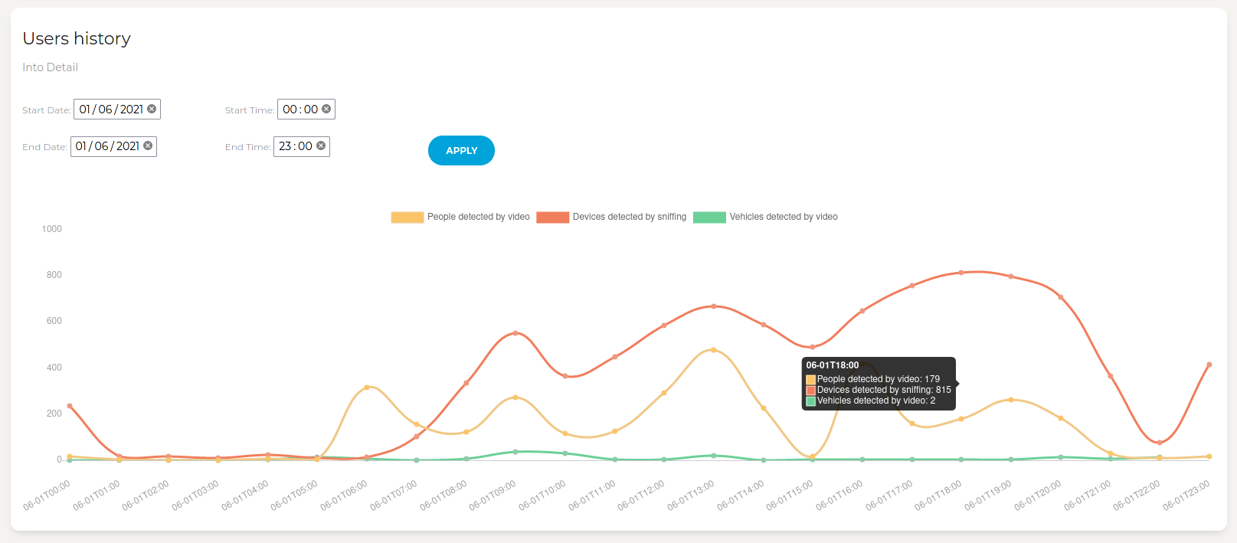
Notes:
[Luisa]

Slide 23
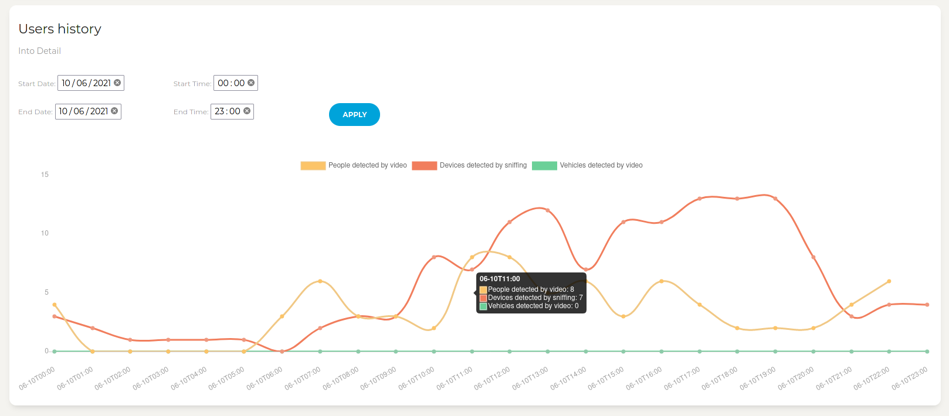
Notes:
[Luisa]

Slide 24
OBUs (On-Board Units) (I)
Estimation of the number of people inside moliceiros using detection of devices through WiFi Detection
1 OBU includes 2 batteries, 1 APU and 1 GPS module
Visualization of the location of the moliceiros via the GPS coordinates
Notes:
[Diogo]

Slide 25
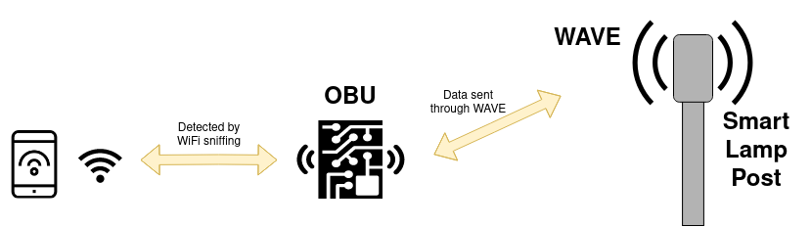
OBUs (On-Board Units) (II)
OBUs in moliceiros do not have direct connection to the internet/ATCLL’s network
Using the smart lamp posts near the Ria de Aveiro (RSUs) the OBUs send data through WAVE to the central server
Notes:
[Diogo]
Falta explicar aqui que colocar a OBU a enviar os dados não foi linear - explicar o que tiveram de fazer
Smartphones - OBU - RSU - Server

Slide 26
OBUs (On-Board Units) (III)
Problem | Solution
Low Signal Strength | Repositioned the OBU to a higher open place in the moliceiros
Higher than expected battery consumption | Placed two batteries in parallel per OBU
Very high number of devices detected | Adjusted the detected packages time to live to obtain more accurate results
Notes:
[Diogo]

Slide 27
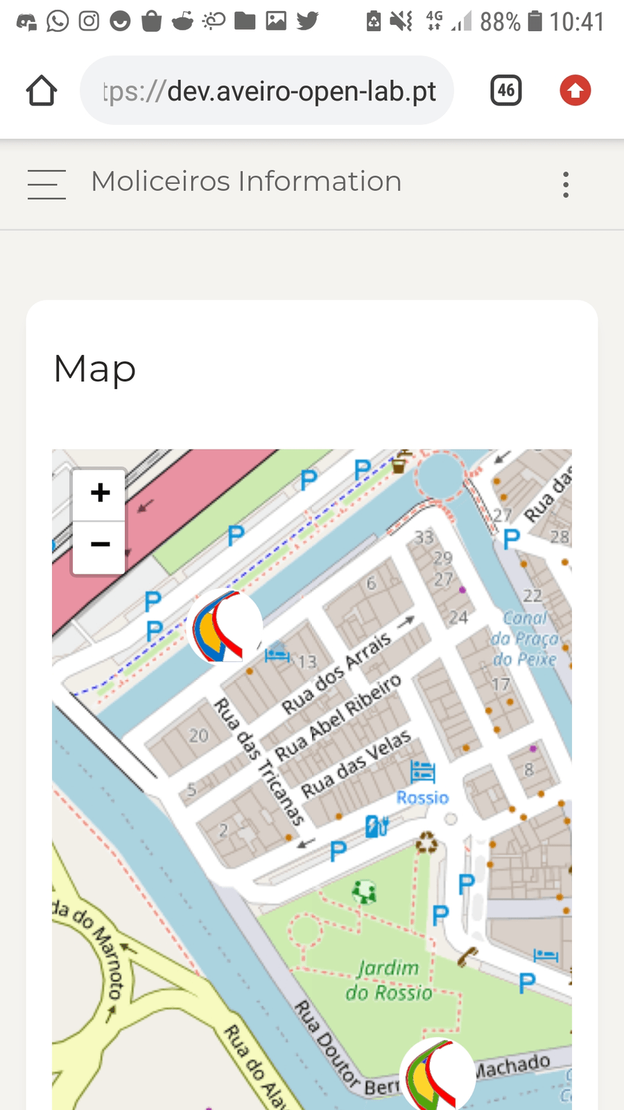
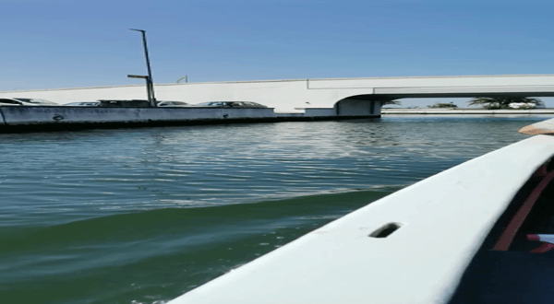
OBUs (On-Board Units) (IV)
Notes:
[Diogo]

Slide 28
Web Application
Notes:
[Hugo]

Slide 29
Web Application - Goals
Display the collected data from the sensors in real-time
Cars, People, Devices.
Display moliceiros moving in a map based on the GPS location
Show past-time data from the sensors
Based on user’s input
Last 24 hours
Notes:
[Hugo]

Slide 30
Web Application - Back End

Slide 31
Back End - Problems
Problem | Solution
Web Sockets didn’t send any data | Use of Server Sent Events (SSEs)
SSEs have a maximum of 6 events at a time | Optimization of the number of SSEs used
Access to the cameras API was limited because it was closed-sourced | Reverse engineering of the camera’s API to access its controls from the Back End
Notes:
[Hugo]

Slide 32
Back End - Results
Back End service : Flask
Subscription to the central broker topics to obtain the real time data
Access to an external API to obtain persisted data
Use of Server Sent Events (SSE) to send the data to the dashboard
Development of an API to simplify and facilitate the access to information
Implementation of an account system, to manage access to certain information
Notes:
[Hugo]

Slide 33
Web Application - Front End

Slide 34
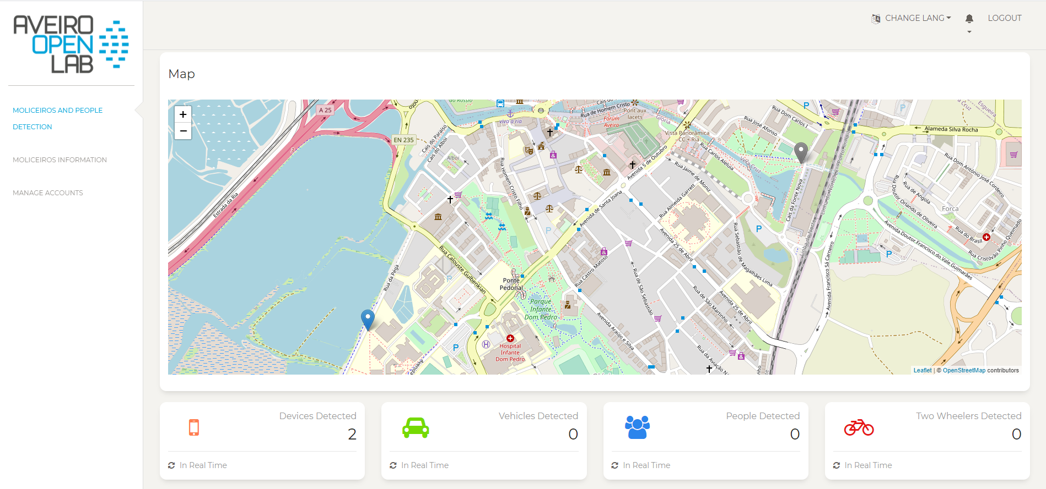
Front End - Results (I)
Moliceiros and People Detection
Map that allows users to switch between Smart Lamp Posts
Notes:
[Maria]

Slide 35
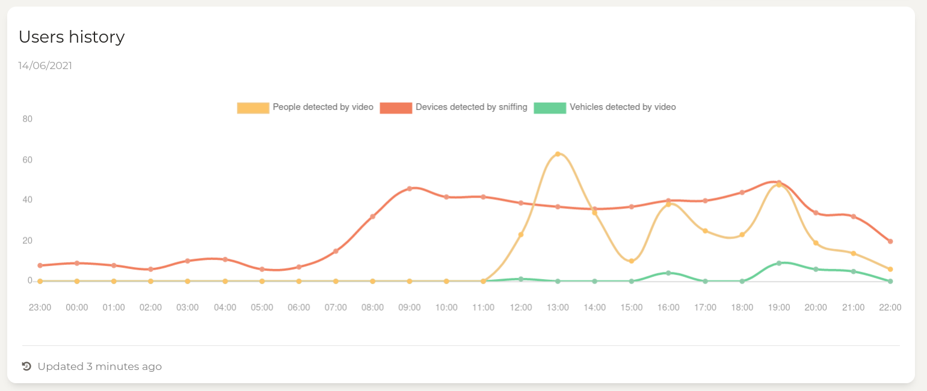
Front End - Results (II)
Moliceiros and People Detection
Display data of real time sniffing, people, cars, two wheelers and moliceiros detection in cards, based on location
Notes:
[Maria]

Slide 36
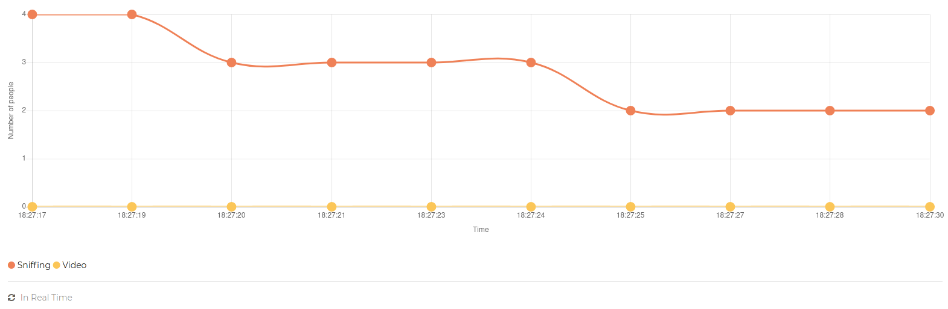
Front End - Results (III)
Moliceiros and People Detection
Visualization of past values in a chart
According to a date and time filter
Last 24 hours
Last 10 real-time values
Notes:
[Maria]

Slide 37
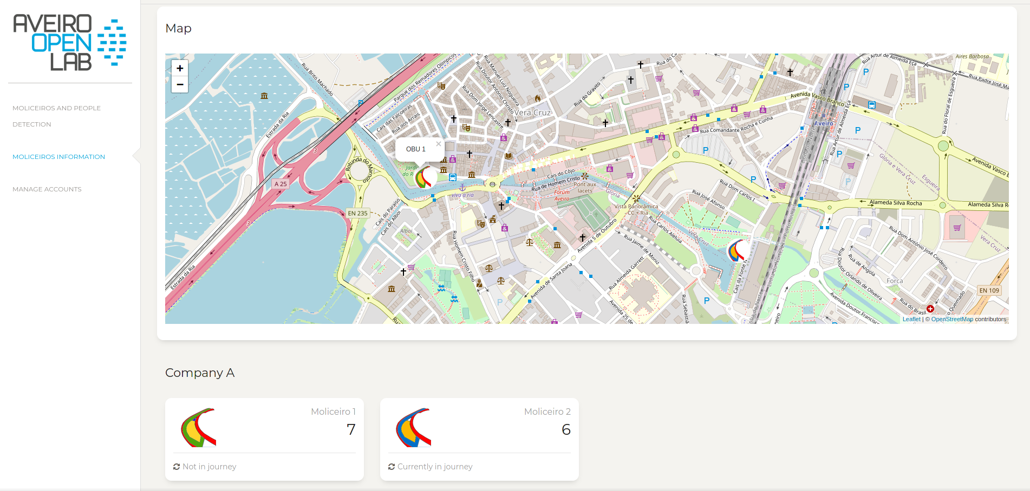
Front End - Results (IV)
Moliceiros information
Display data of real time sniffing in moliceiros in cards, for each moliceiro
Display moliceiro’s locations in map
Notes:
[Maria]

Slide 38
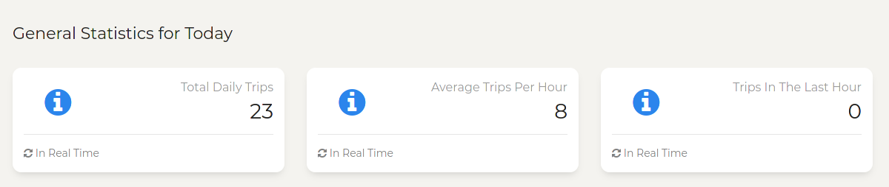
Front End - Results (V)
Moliceiros information
Display general statistics of moliceiros in a day
Total daily trips
Average trips per hour
Trips in the last hour
Notes:
[Maria]

Slide 39
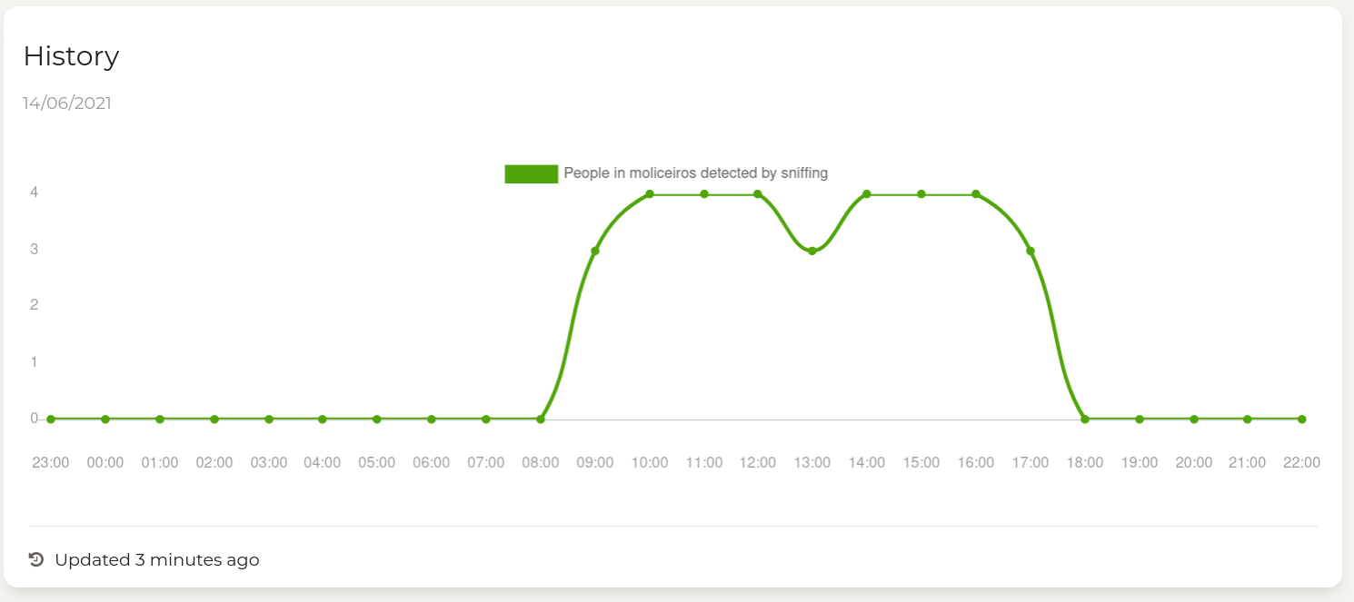
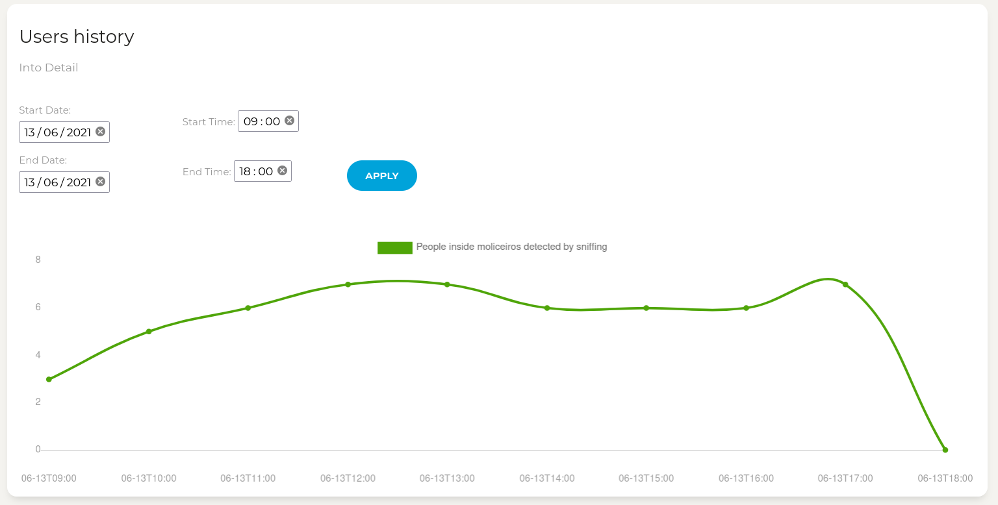
Front End - Results (VI)
Moliceiros information
Visualization of past values in a chart
According to a date and time filter
Last 24 hours
Last 10 real-time values
Notes:
[Maria]

Slide 40
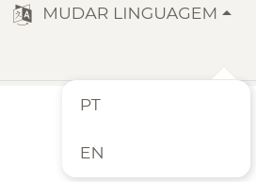
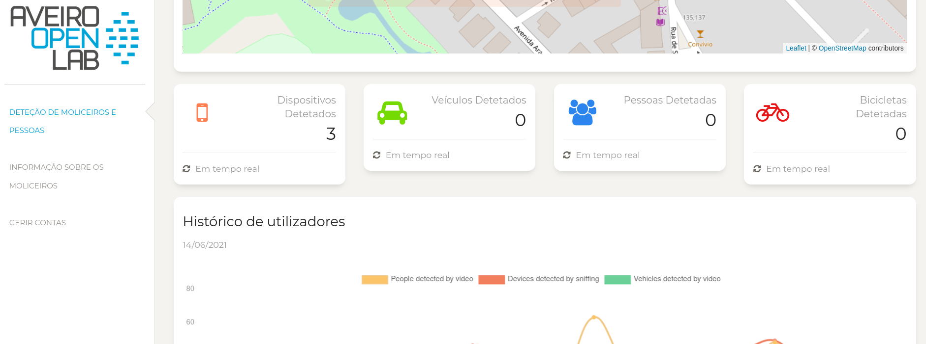
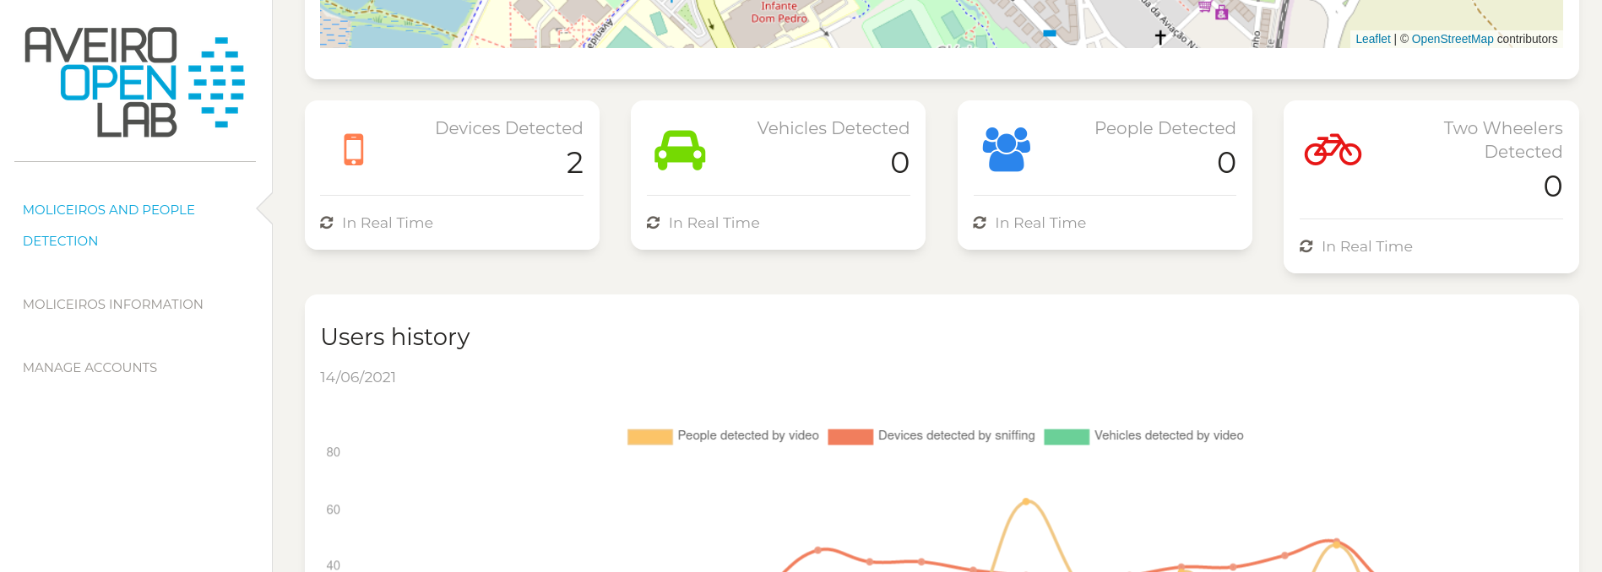
Front End - Results (VII)
General
Language translations
Notes:
[Hugo]

Slide 41
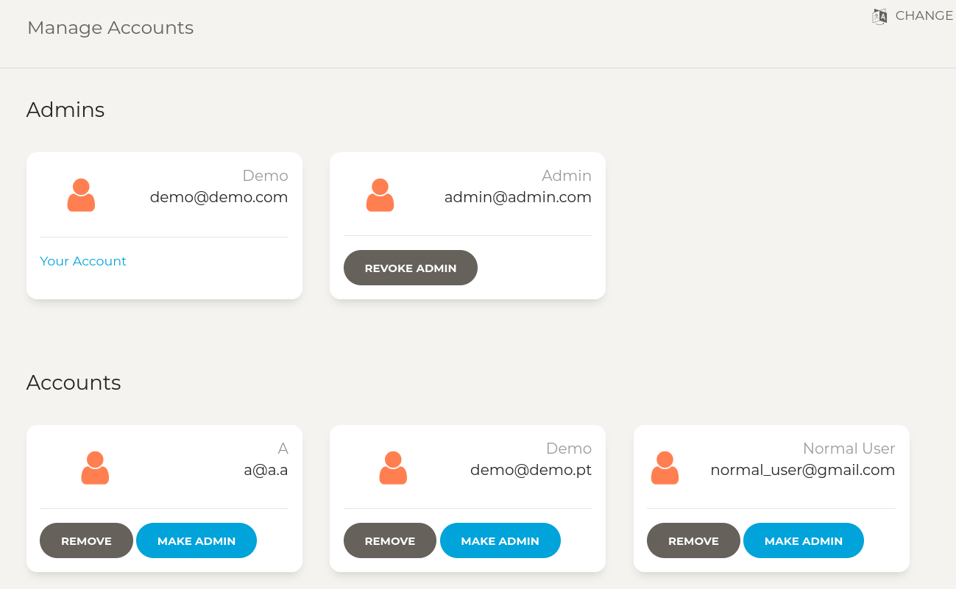
Front End - Results (VIII)
General
Account system to protect moliceiros information
Notes:
[Hugo]

Slide 42
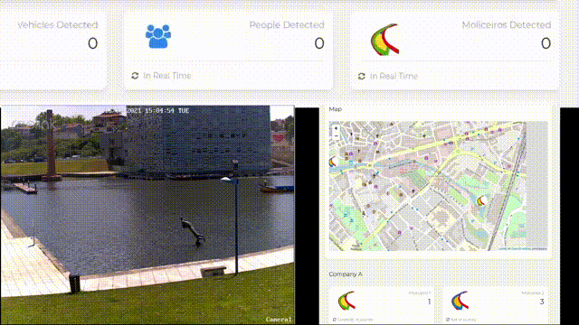
Front End - Results (IX)
Information obtained by sniffing
Moliceiros Detection using the camera
Notes:
[Hugo]

Slide 43
Initial goals (I)
Develop solutions to get values from the sensors and understand which type of sensors to use
Develop mechanisms to detect people, moliceiros, movement, etc.
Use of different sensors
WiFi devices detection
Video AI for object detection
Sensor fusion and processing
Notes:
(considering video cameras also as sensors)

Slide 44
Initial goals (II)
Develop a subscription broker to accumulate past and real time data
Develop a web application to show the subscription broker’s data
Overall data processing, persistence, analytics and visualization in the web application
Improve team-working skills and learn how to work with new technologies and equipments
Documentation writing

Slide 45
Achieved goals
Extra goals achieved
All initial goals were achieved!
Use of OBUs (On-Board Units) in the middle step between the smartphones and the edge devices
OBUs with Wi-Fi sniffing
Estimation of the number of people inside a moliceiro by detecting how many devices are in proximity

Slide 46
Future Work
Increase the accuracy of the number of devices detected through Wi-Fi Sniffing
Implement the detection of moliceiros, people and vehicles using the same model and coordinating with the different positions of the camera
Implement the data acquisition in other smart lamp posts in the city

Slide 47
Mobility platform in Aveiro Tech City Living Lab Infrastructure
Milestone 4
Diogo Mendes, 88801
Hugo Leal, 93059
Luísa Amaral, 93001
Maria Cunha, 93089
Pedro Loureiro, 92953
Supervisors:
Dr.ª Susana Sargento
Dr. Pedro Rito

